Slide 1
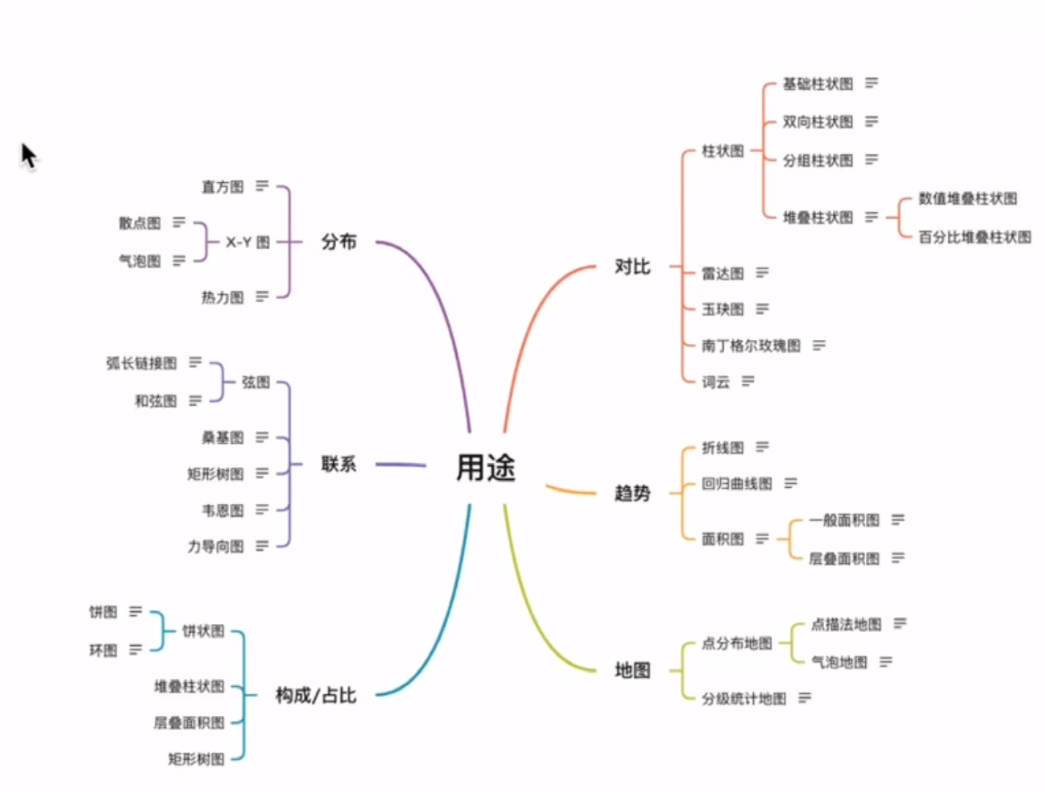

Slide 2
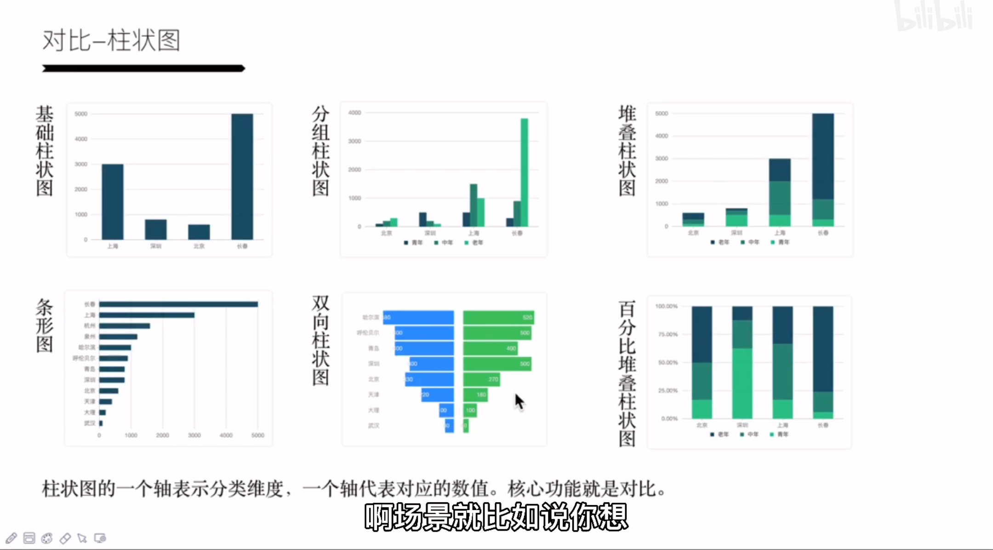

Slide 3
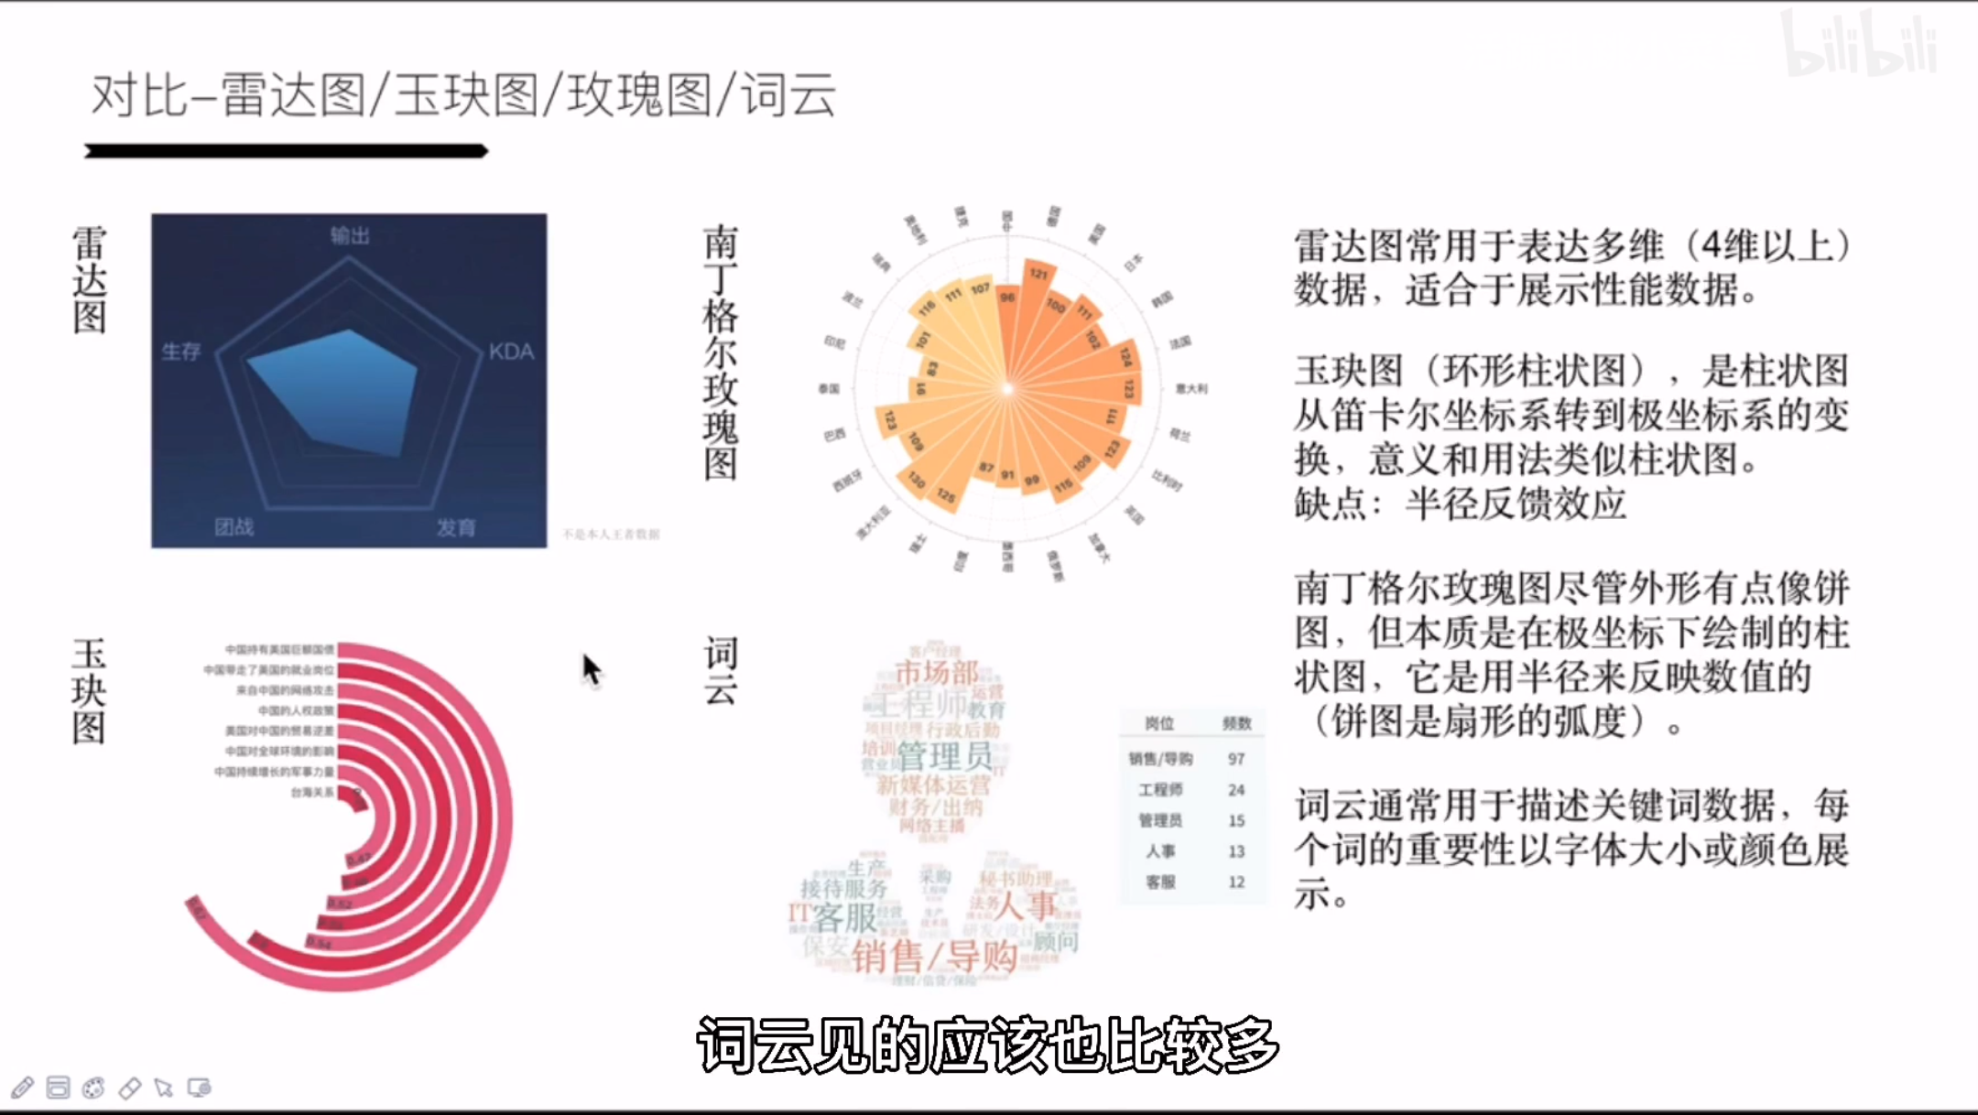

Slide 4
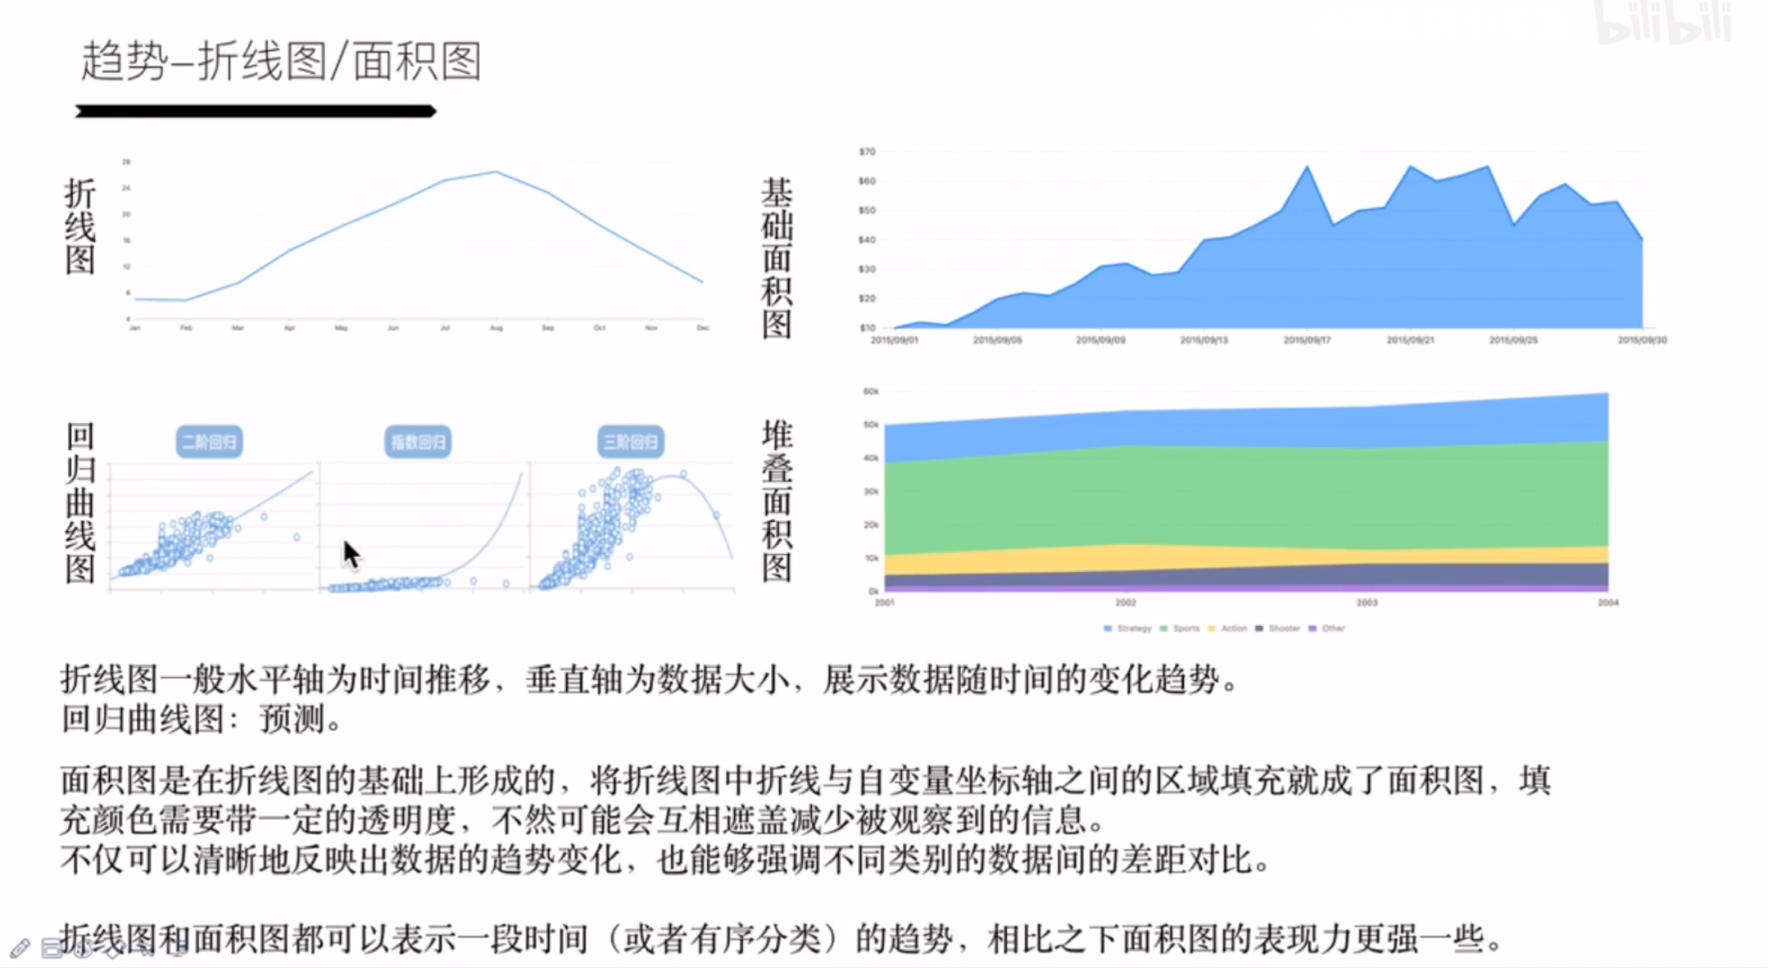

Slide 5
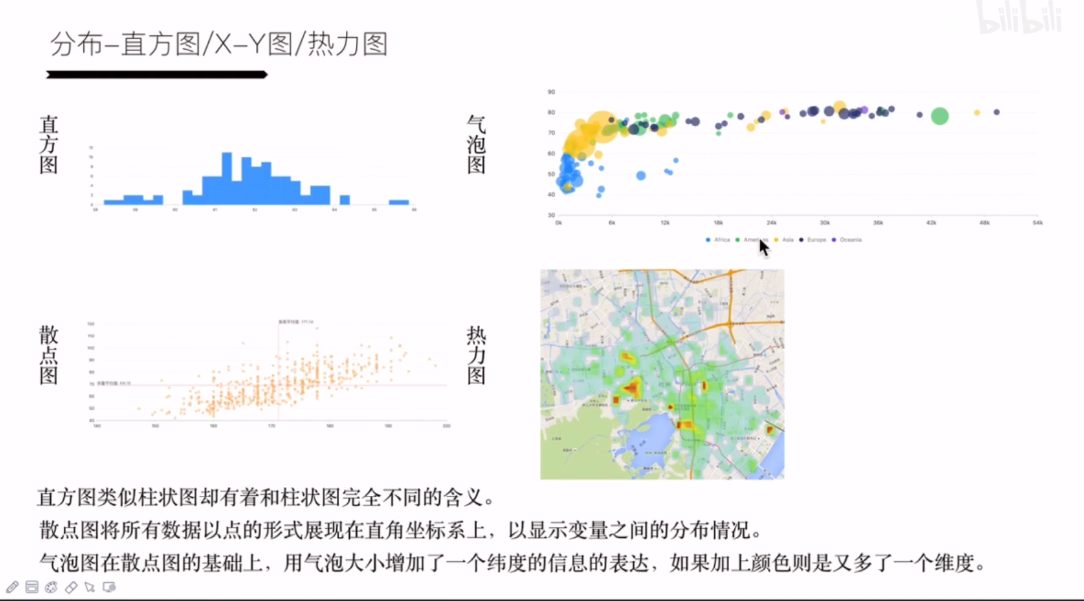

Slide 6
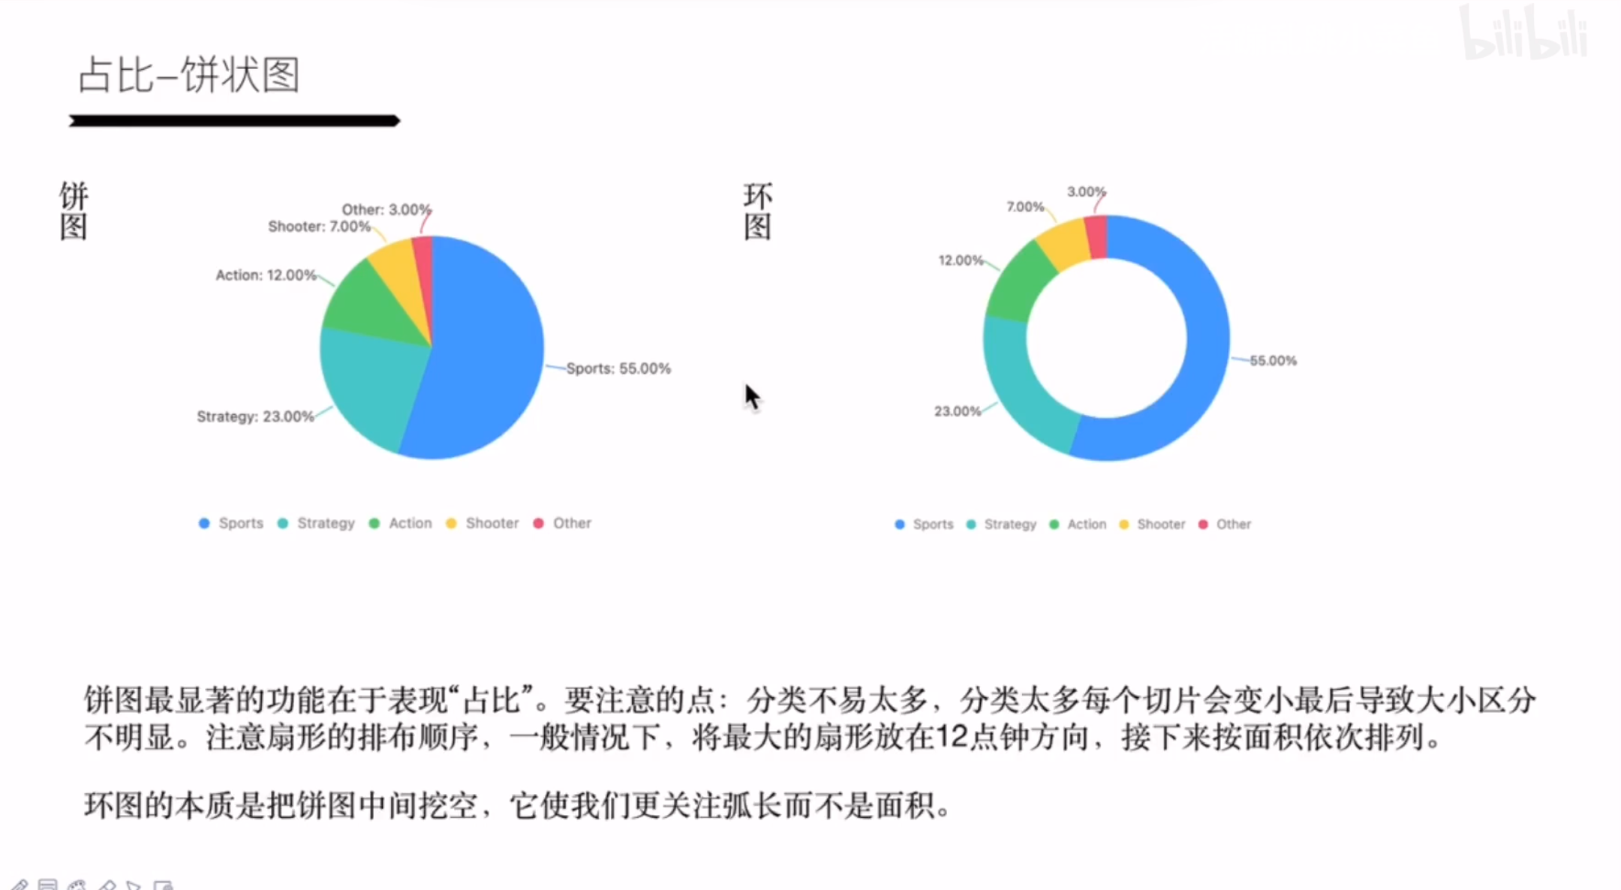

Slide 7
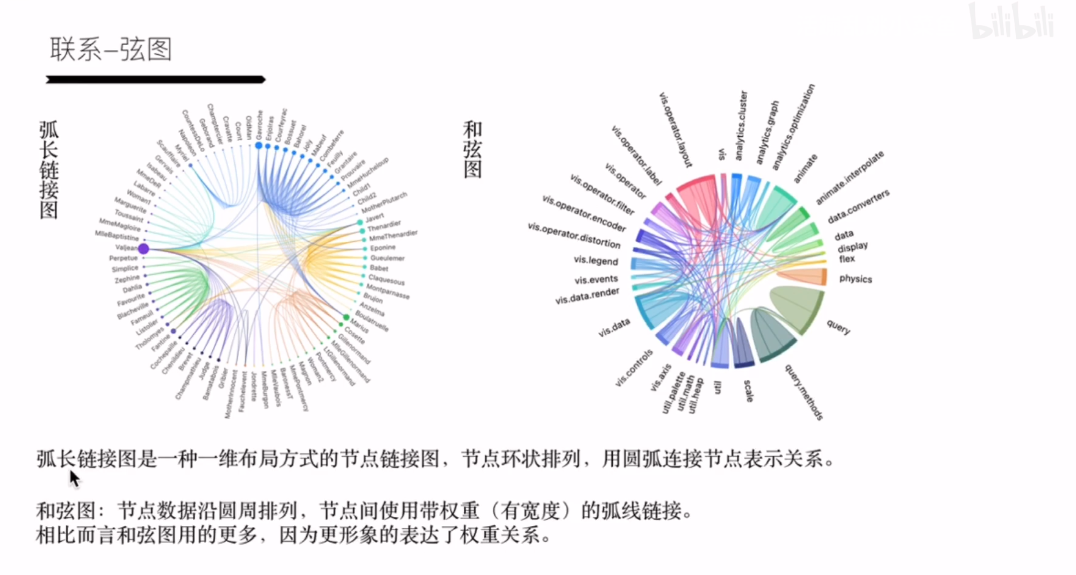

Slide 8
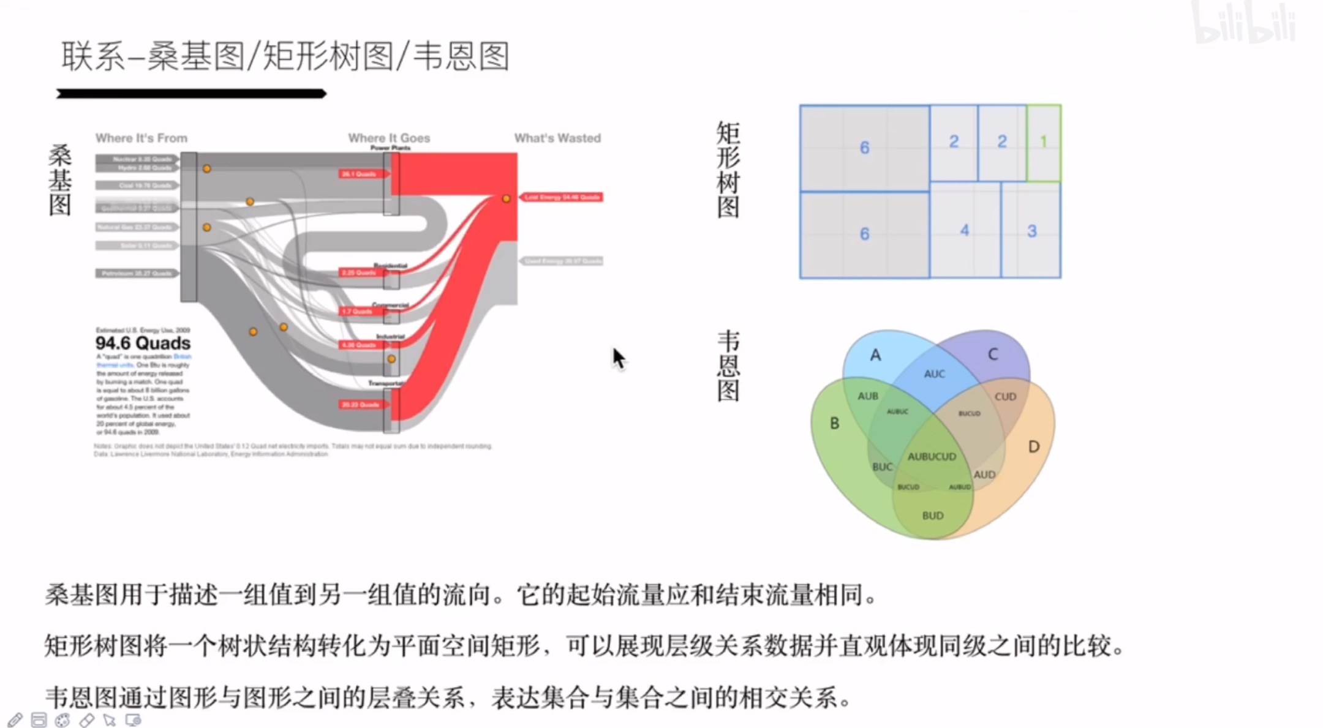

Slide 9
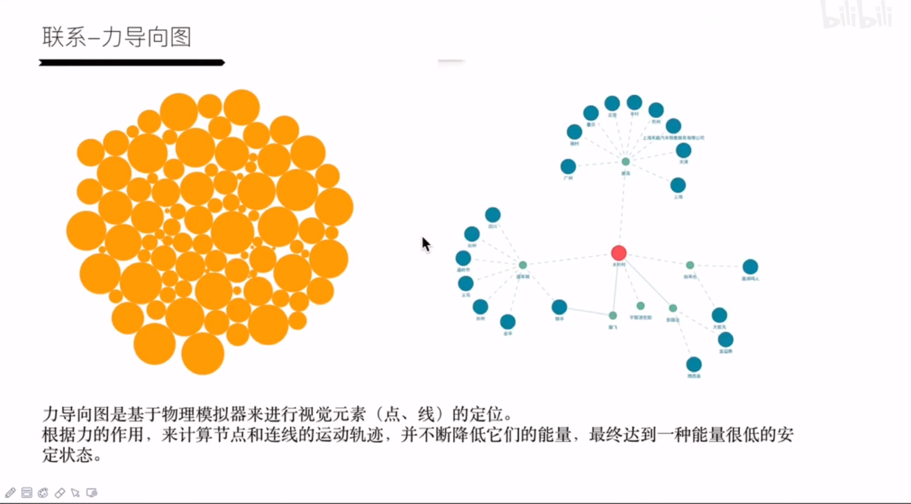

Slide 10
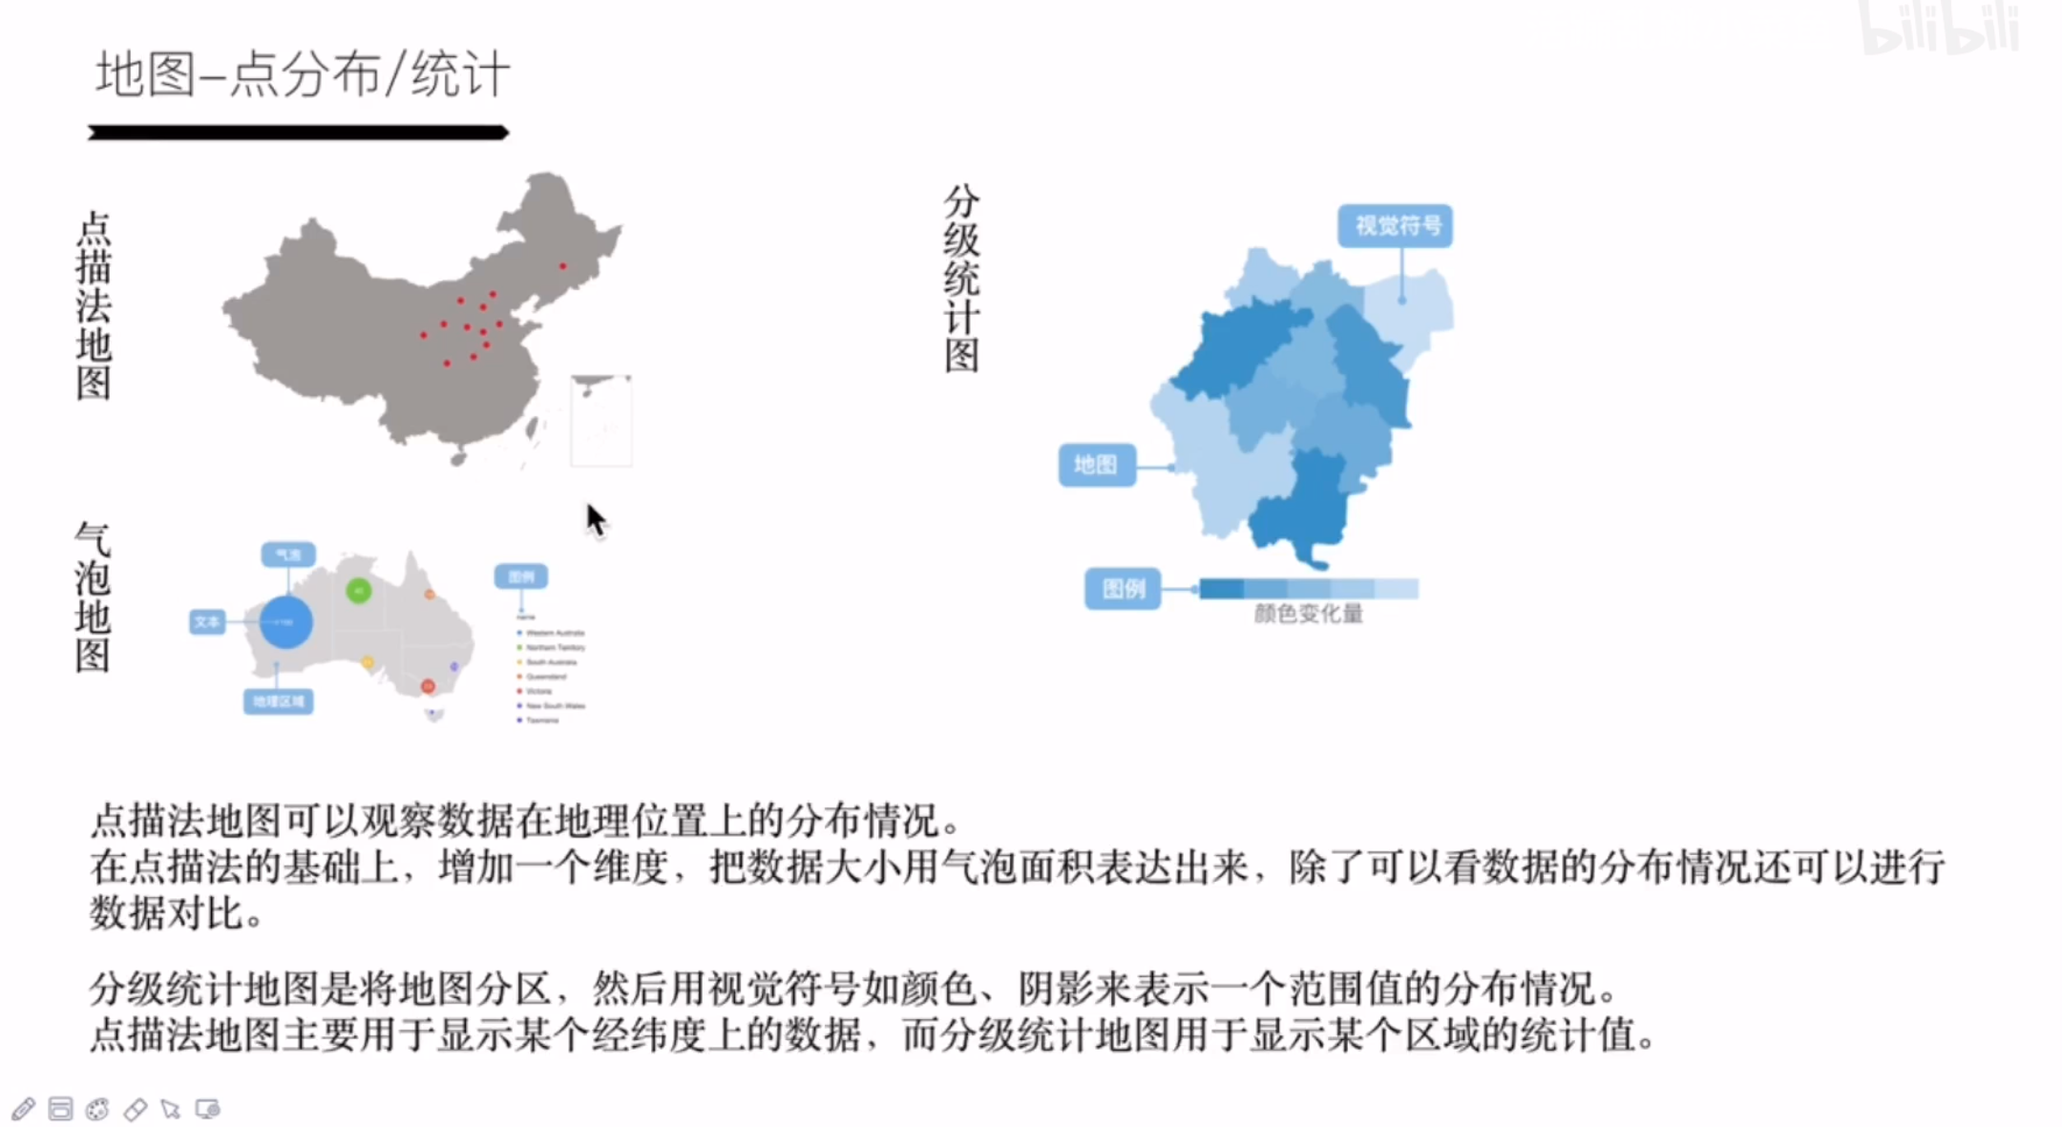

Slide 11
折线图

Slide 13
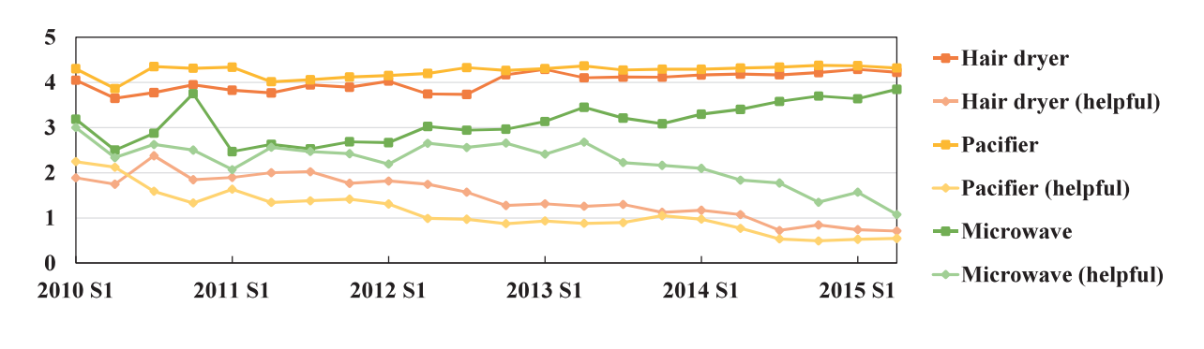
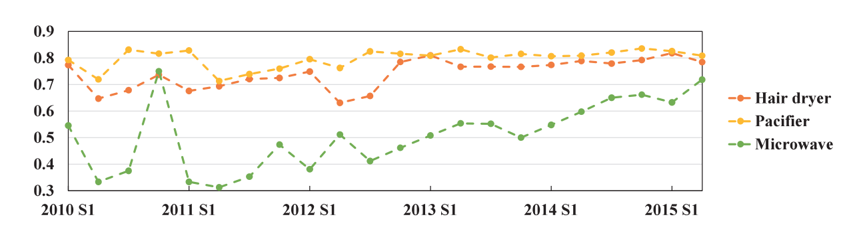

Slide 14
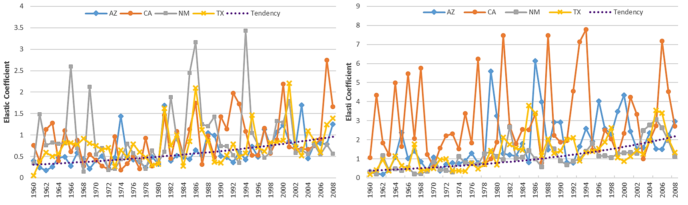

Slide 15
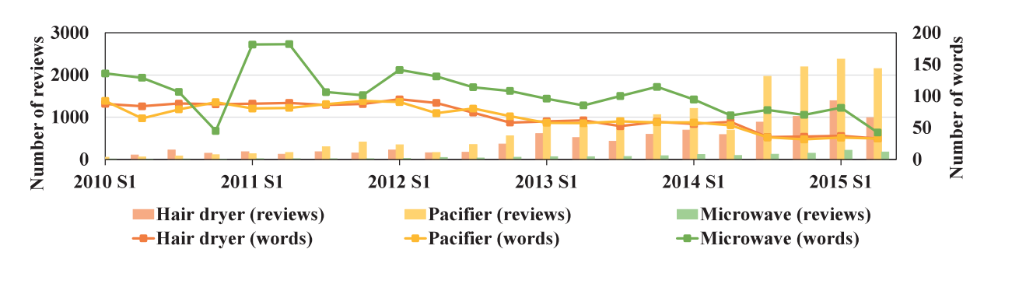

Slide 16
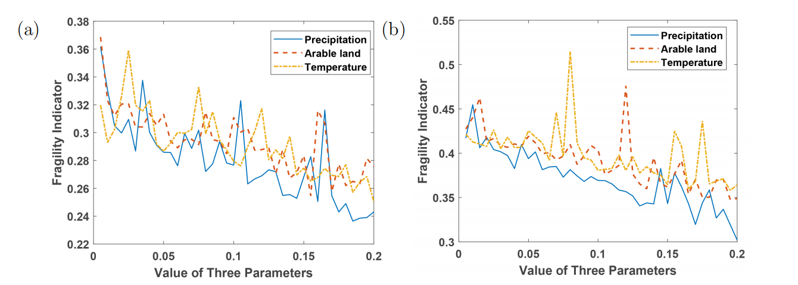

Slide 18
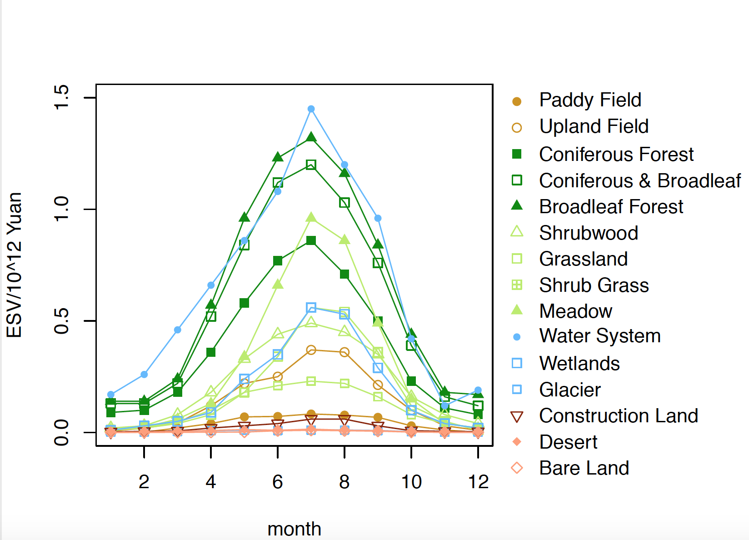

Slide 26
直方图/堆积图

Slide 27
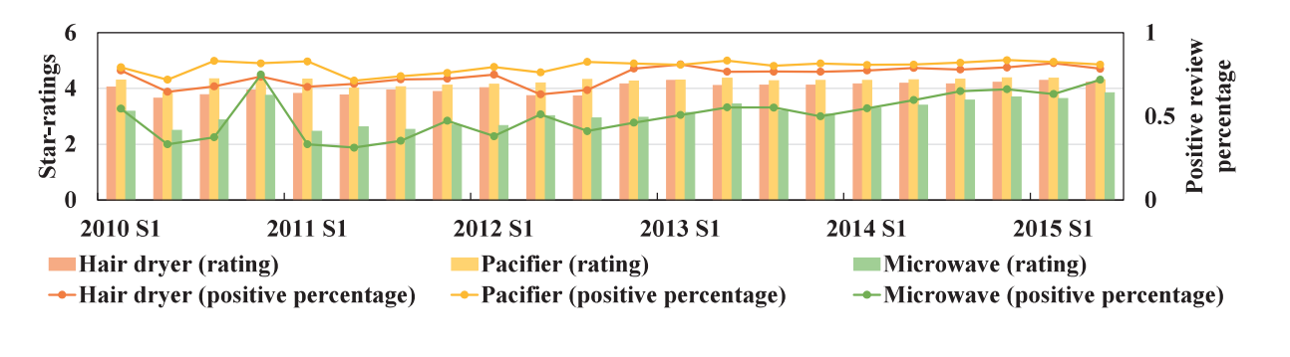
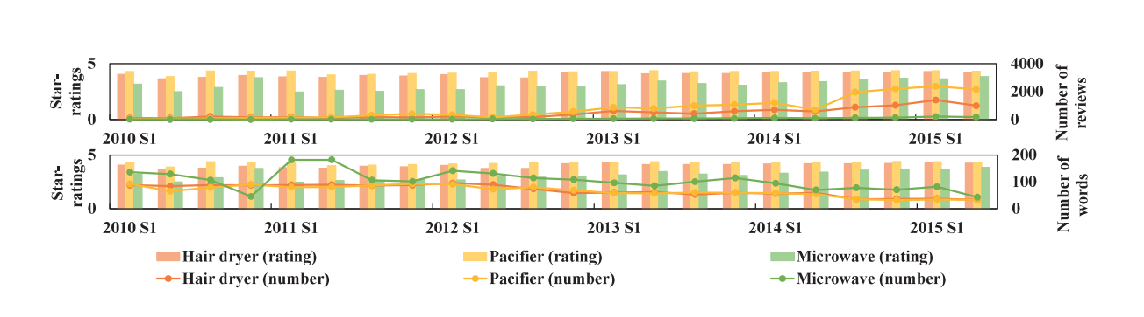

Slide 28
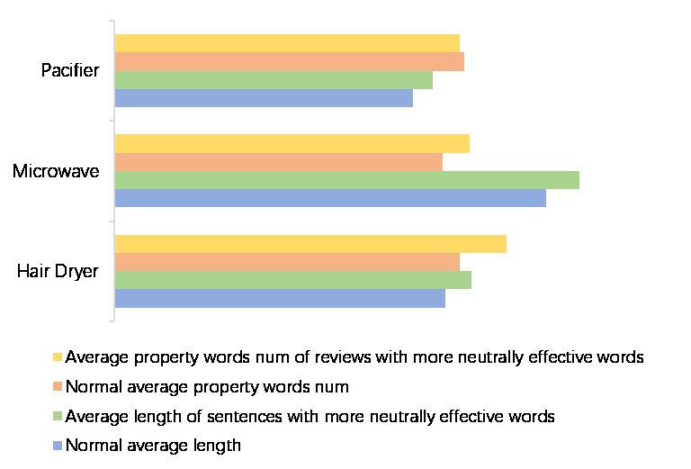

Slide 29
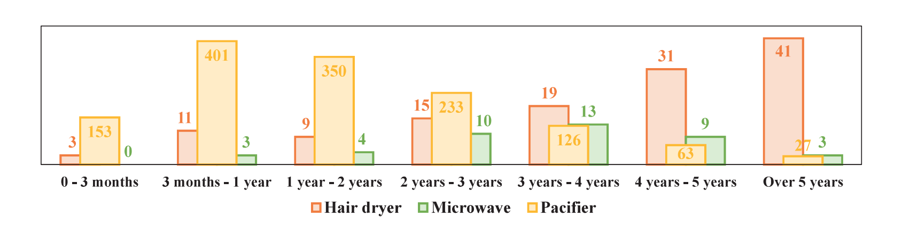

Slide 30
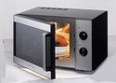
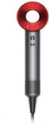
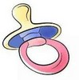
Total number
Microwave
667
300
134
112
402
1616
Hair dryer
6740
2096
999
639
402
11471
Pacifier
12620
2707
1424
945
1196
18931

Slide 31
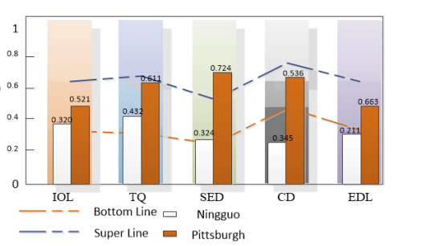

Slide 33


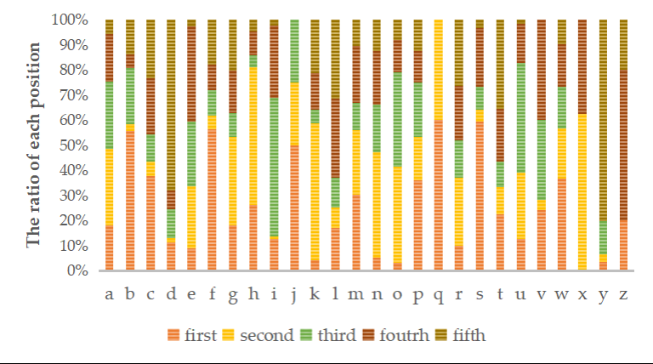

Slide 34
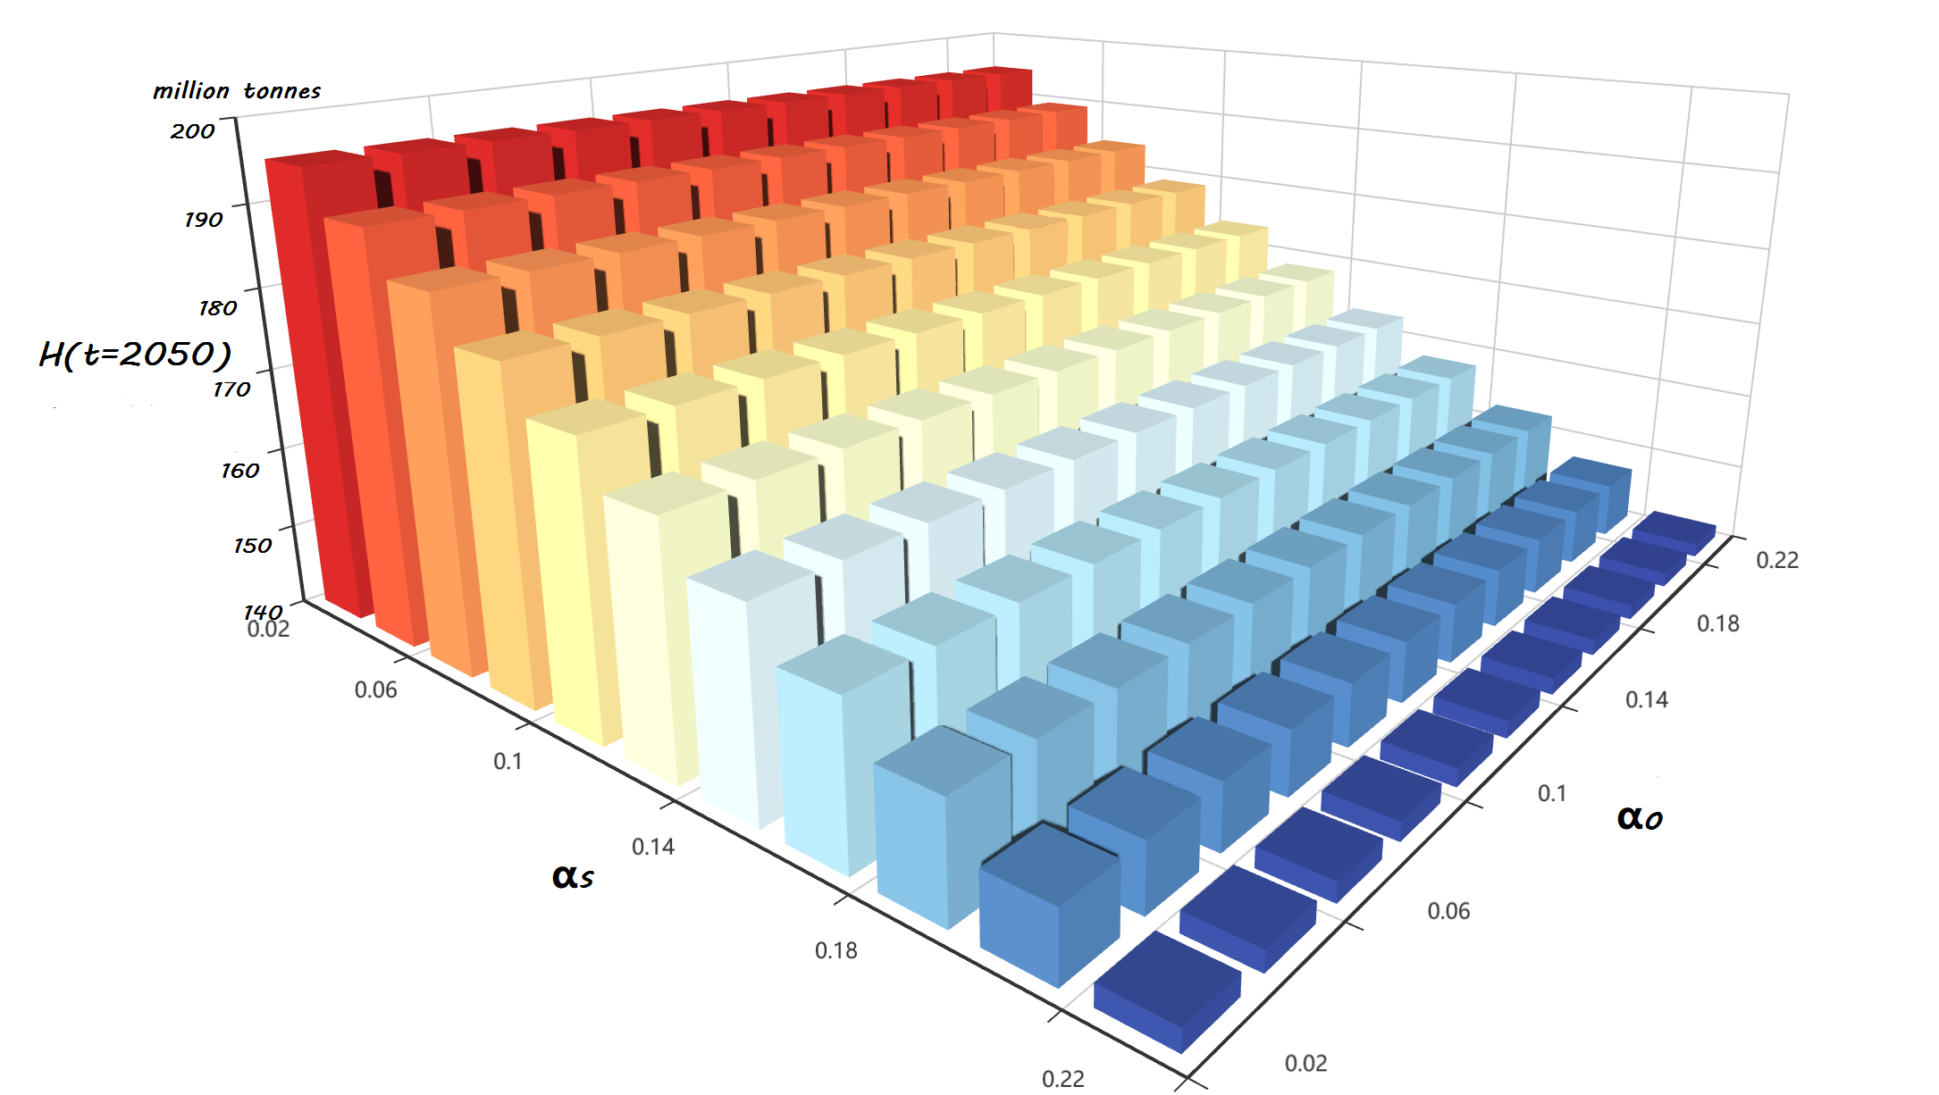

Slide 35
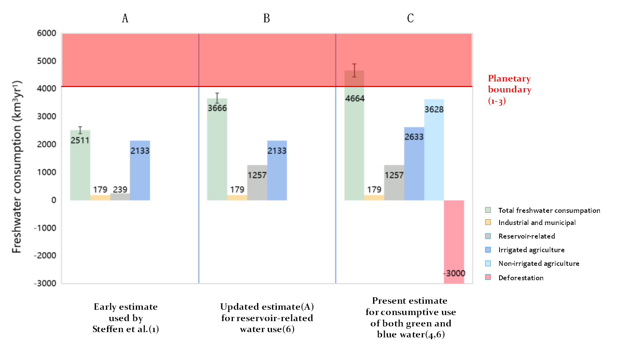

Slide 36
散点图

Slide 37
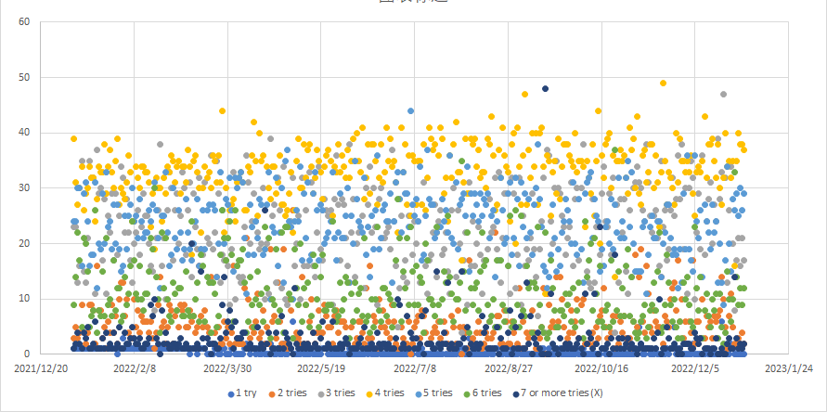

Slide 38
箱型图

Slide 39
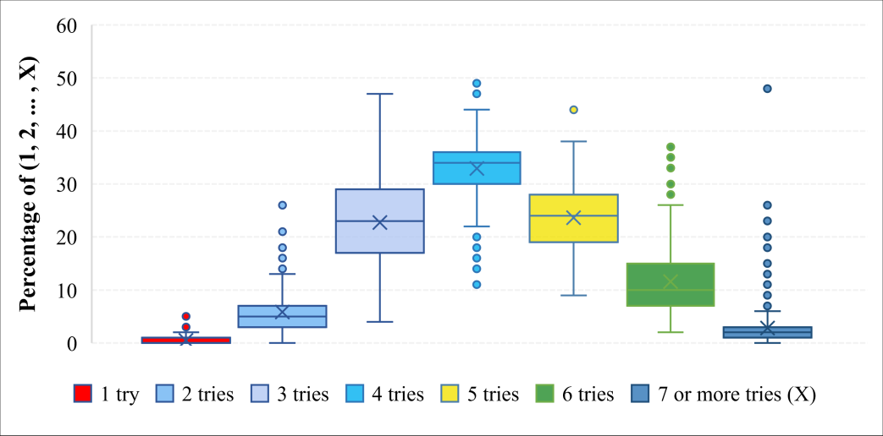

Slide 40
饼图 /圆环图

Slide 42
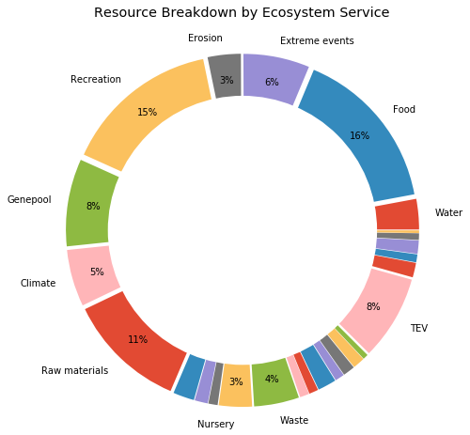

Slide 44
雷达图

Slide 45
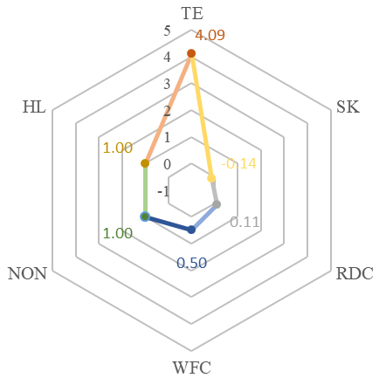

Slide 46
词云图

Slide 47
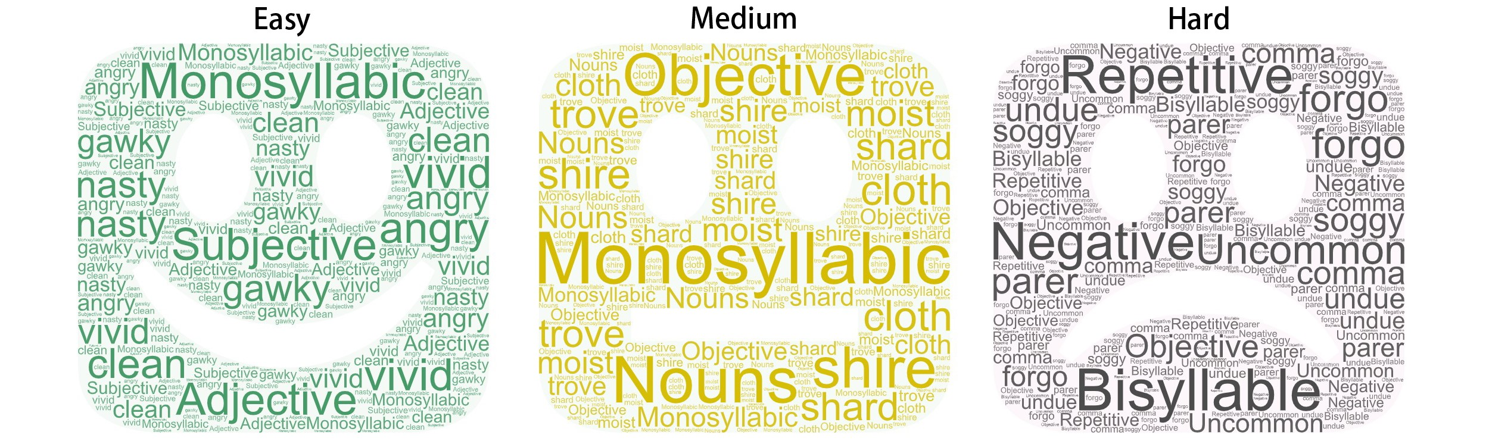

Slide 48


Slide 49
层次图/分子图

Slide 50
ABC

Slide 51
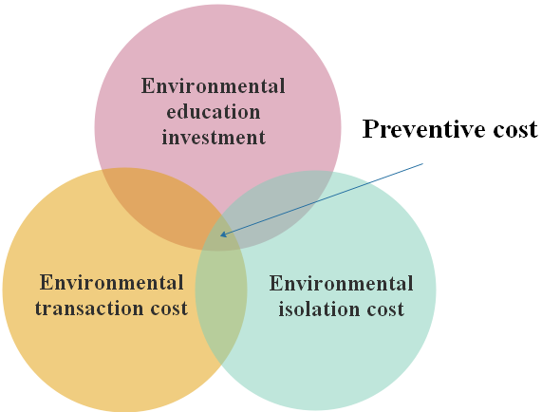

Slide 52
Wood
Products
Value
Forest
By-products
Value
Economic
Value
Carbon Sequestration Value
Cultural Heritage
Value
Total
Value
Ecological
Value
Social
Value
Recreational function
value
Water Conservation Value
Soil Sequestration Value
Research and education value

Slide 53
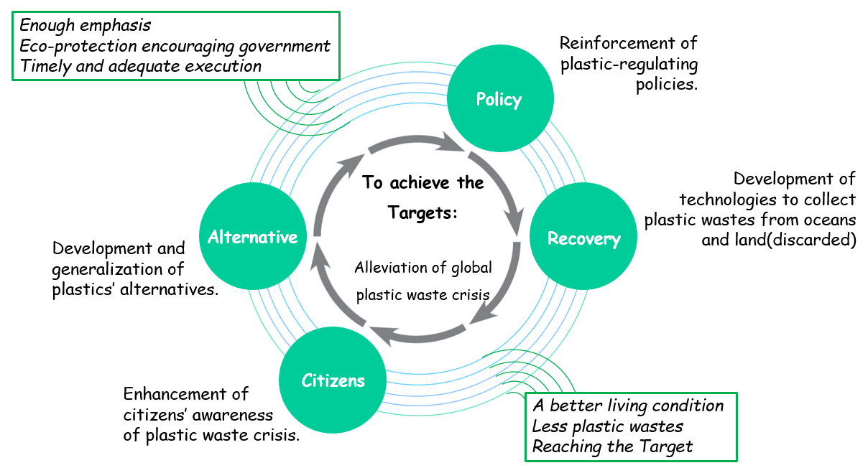

Slide 54

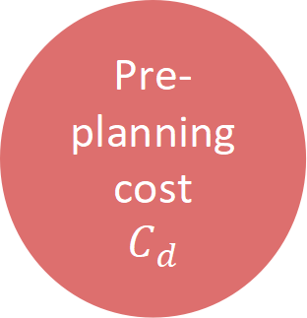
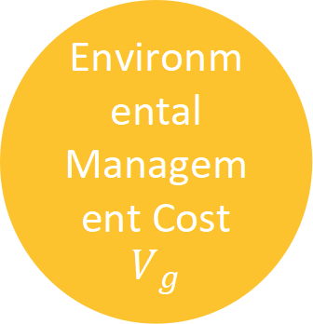
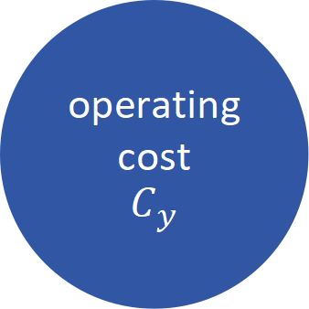

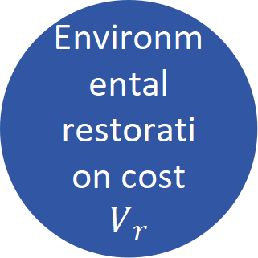


Environmental resource cost
$$V_{k}$$
Pre-planning cost
$$C_{d}$$
Total Land Project Cost
C
External cost
$$C_{w}$$
Internal cost
$$C_{n}$$
Environmental Management Cost
$$V_{g}$$
construction cost
$C_{b}$
Environmental restoration cost
$$V_{r}$$
operating cost
$$C_{y}$$

Slide 55
三角图/金字塔图

Slide 56
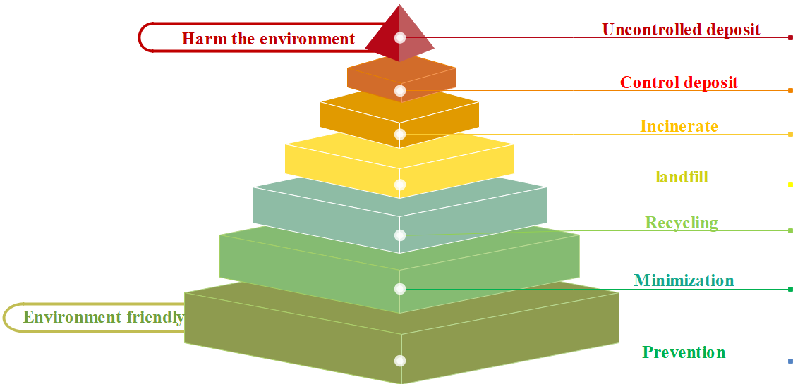

Slide 58
热力图/地图

Slide 59
-0.023
0.011
0.046
1.000
Letter
Frequency
-0.3
-0.227
-0.159
1.000
0.046
Letter Repetition
0.015
1.000
-0.159
0.011
Word Frequency
1.000
0.015
-0.227
-0.023
Failure
1.0
Failure
Word Frequency
Letter Repetition
Letter
Frequency

Slide 60
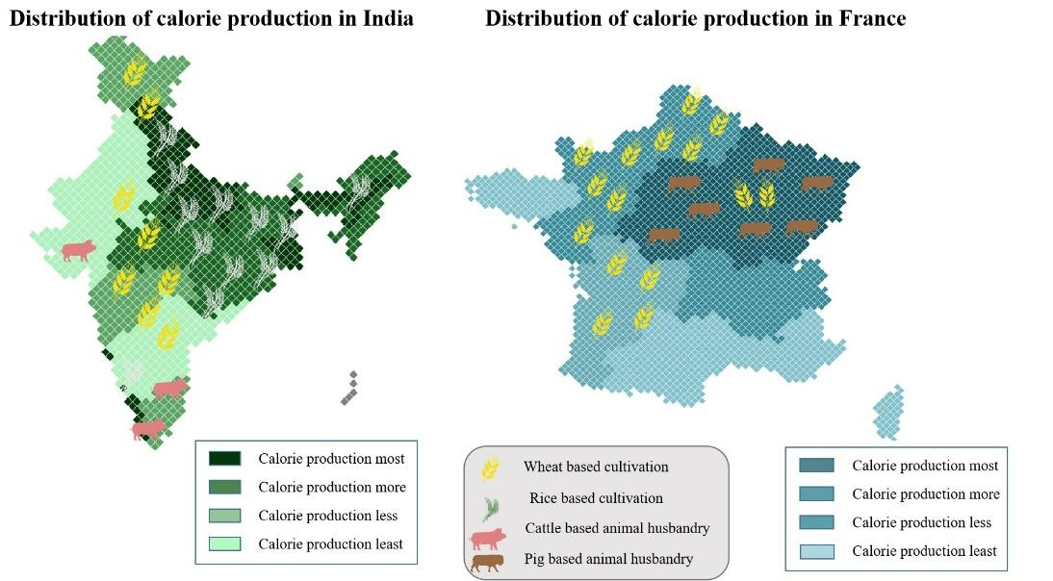

Slide 61
流程图

Slide 63
给予数据
目标
和
行动
历史演变的特征
相关性分析
能量分布图评估
能源分布预测
选择
聚合
时间衰减权重
滑动窗口
高斯过程回归
灰色关联分析
熵权矩阵
皮尔逊相关
分析
TOPSIS
皮尔逊相关
分析
给予数据
误差分析
偏相关分析
自回归滑动平均
影响因素
CAFE
FRAMEWORK
相似性度量
高斯回归过程

Slide 64
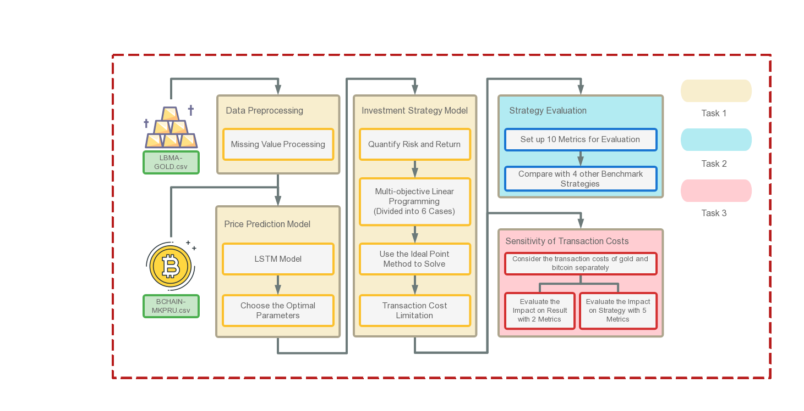

Slide 65
Given Data
Prediction for Reported Results
Filtering of Word Attributes
Proportion of Word Attributes
Decision Tree Classification
Data Cleaning
Initial Forecast Based on ARIMA
Letter Repetition
Fuzzy Comprehensive Evaluation
Letter Repetition
Input Data
LSTM for Correction
Letter
Frequency
Letter
Frequency
Analytic Hierarchy Process
Input Data
Input Data
Spearman Correlation Analysis

Slide 66
Given Data
Prediction for Reported Results
Filtering of Word Attributes
Proportion of Word Attributes
Decision Tree Classification
Data Cleaning
Initial Forecast Based on ARIMA
Letter Repetition
Fuzzy Comprehensive Evaluation
Input Data
LSTM for Correction
Letter
Frequency
Analytic Hierarchy Process
Input Data
Spearman Correlation Analysis

Slide 67
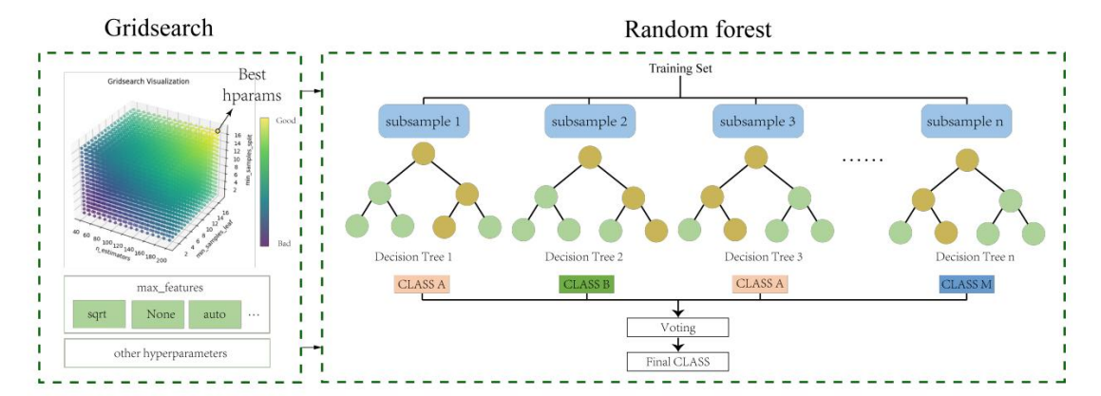
Gridsearch
Random forest
Training Set
subsample 1
subsample 2
subsample 3
subsample 4
……
Decision Tree 1
Decision Tree 2
Decision Tree 3
Decision Tree 4
CLASS A
CLASS B
CLASS A
CLASS B
…

Slide 68
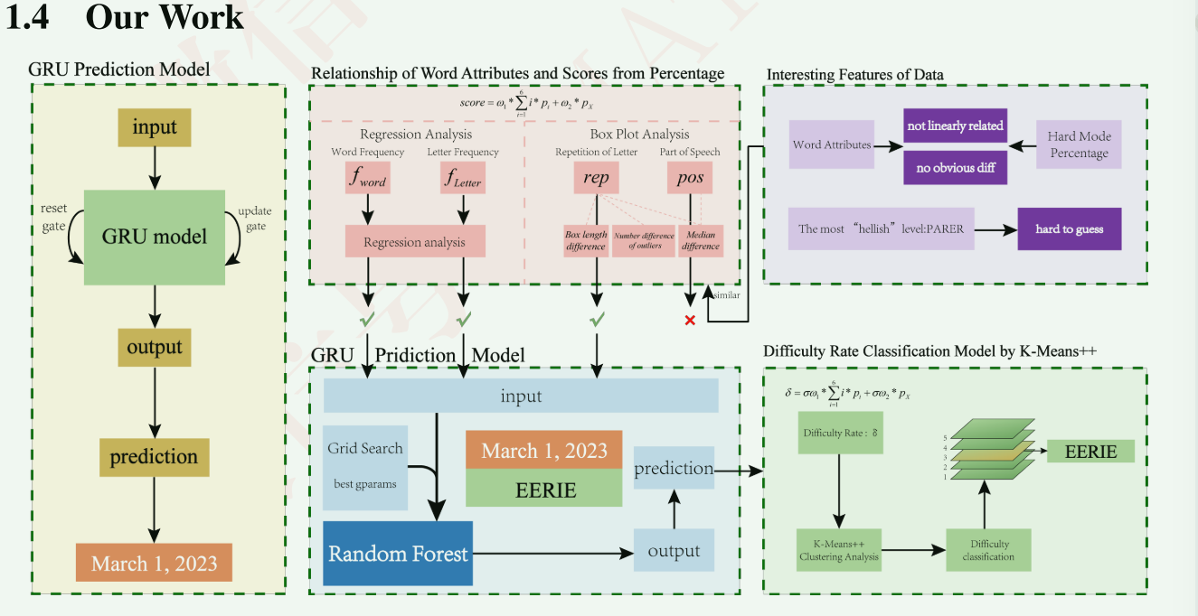

Slide 69
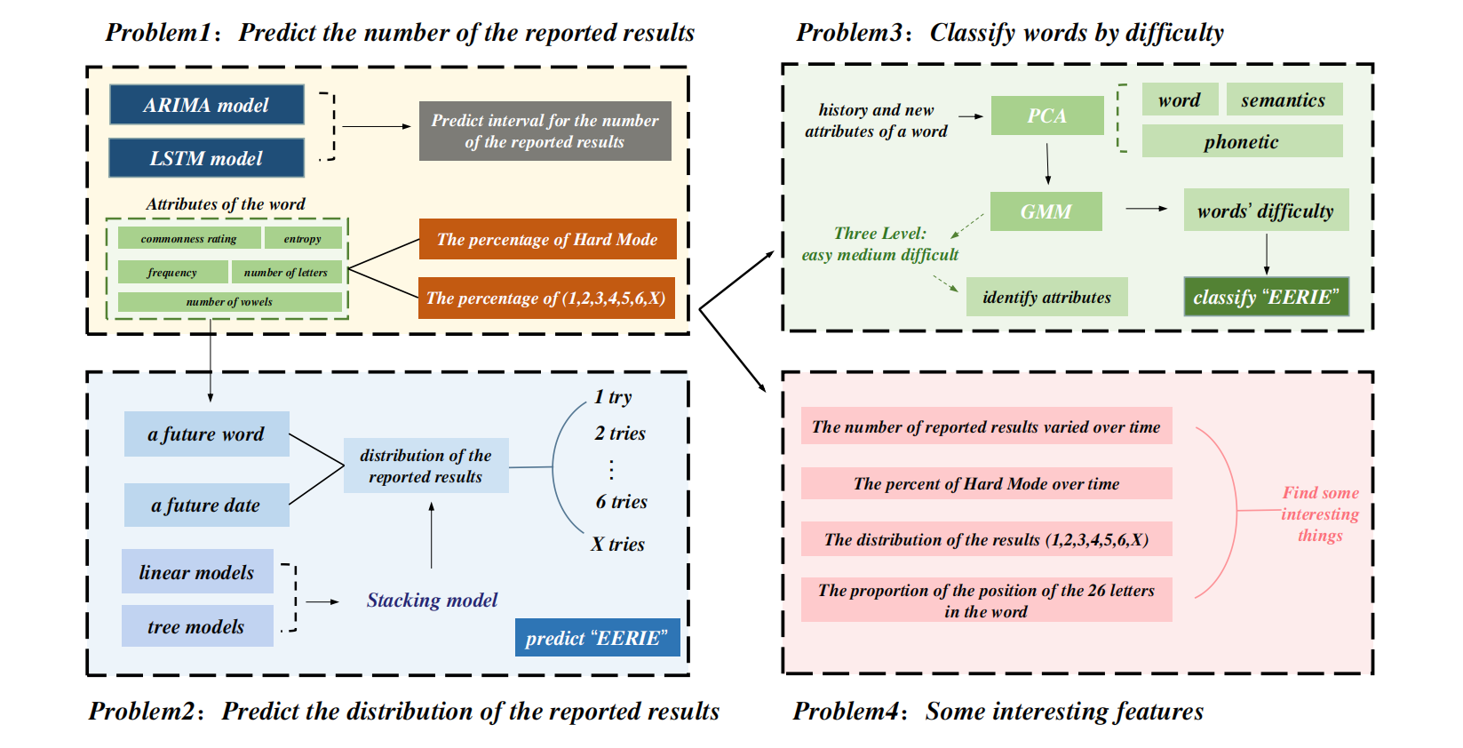

Slide 70
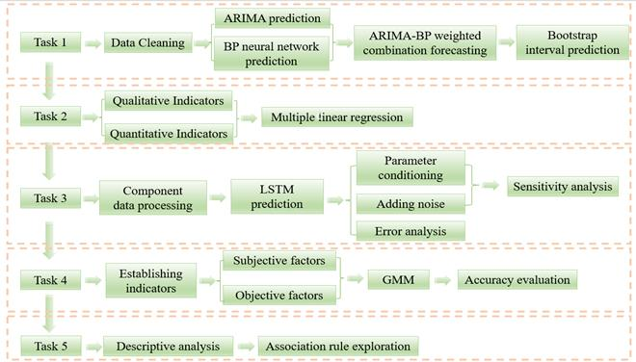

Slide 71
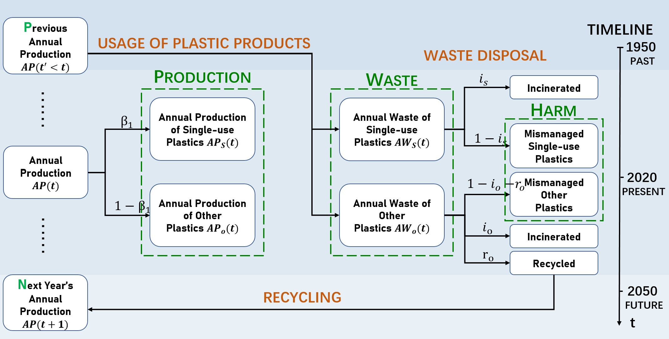

Slide 72
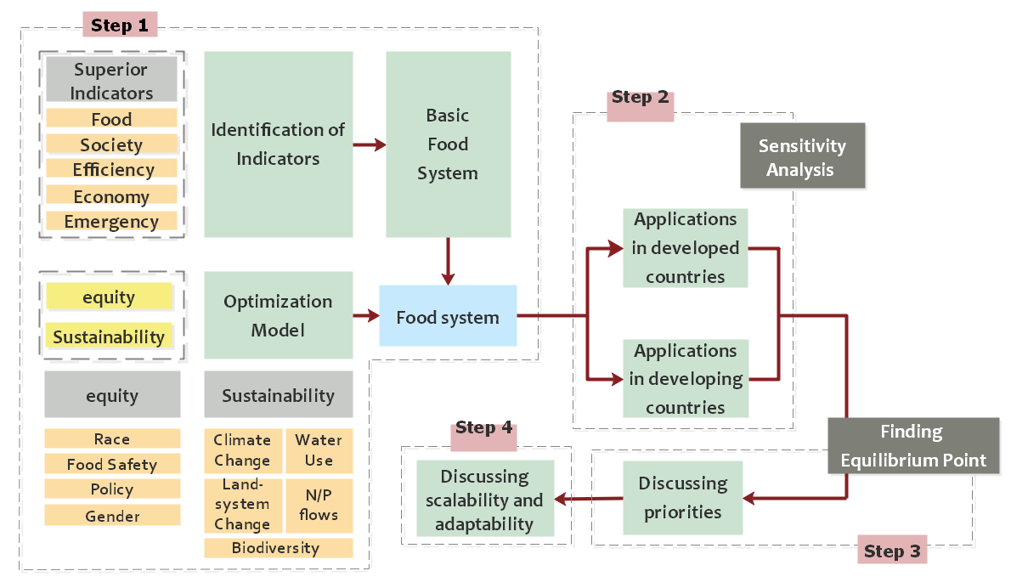

Slide 73
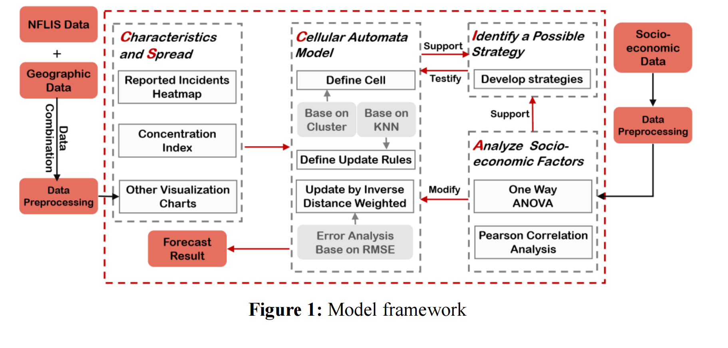

Slide 74
Resource Scarcity
Social development stage coefficient
Wolongpo
ESV
Case Studies
Advice
Yellow River Delta
Environmental Resource Cost
Environmental Management Cost
Environmental Restoration Cost
Implications on Land Use Project Planners and Managers
Internal Cost
External Cost
Benefit-Cost Ratio
Information Entropy
Cost Distribution Map
Benefit Analysis
Cost Analysis
Markov
Chain
Changes in land status
Coordinated Development Degree
Cost and
Benefit Analysis
Changes over time
Changes in Benefit-Cost Ratio
Region Type

Slide 75
目标层
建立层次结构模型
准则层
特征向量
归一化
方案层
构造判断矩阵
层次单排序
（计算权重向量）
层次分析法
调整判断矩阵
通过一致性检验
否
是
层次总排序
得到结果

Slide 76
思维导图

Slide 77


Recycle
Recycle
Incineration
Incineration
Landfill
Landfill
Ocean deposit
Ocean deposit
Recycle
Waste management
Classification of county
Classification of county
Incineration
Landfill
Maximum levels of plastic waste
Ocean deposit
Analyze Singapore& Italy
PCA
$$EBQ$$
Environment bearing rate
$$EBC$$
Waste management
Reduction level of plastic waste
PCA
Environment bearing rate
Human-friendly indicator
Environment safe
Analyze Singapore& Italy
Recycle
Classification of county
Environment bearing rate
Incineration
Landfill
Ocean deposit

Slide 78
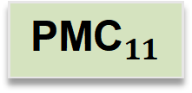
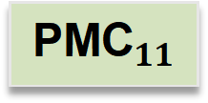

Analyze US
Degradable plastics
Degradable plastics
MPMV
Calculate suggested plastics mitigation volume (SPMV)
Analyze Singapore& Italy
Degradable plastics
$${\text{PMC}}_{11}$$
$${\text{PMC}}_{11}$$
Analyze Singapore& Italy
$${\text{PMC}}_{11}$$
$${\text{PMC}}_{11}$$
MPMV
$${\text{PMC}}_{11}$$
$${\text{PMC}}_{11}$$
Analyze Singapore& Italy
Estimated PMC
Estimated PMC
Intervention

Slide 79






Slide 81
Gridsearch
Random forest
Training Set
subsample 1
subsample 2
subsample 3
subsample 4
……
Decision Tree 1
Decision Tree 2
Decision Tree 3
Decision Tree 4
CLASS A
CLASS B
CLASS A
CLASS B
…

Slide 83


Slide 85
表格颜色参考

Slide 86



Slide 87


Slide 88


Slide 89


Slide 90


Slide 91


Slide 92


Slide 93
25
73
60%
73%

Slide 94
TEXT HERE
本图表由@Simon_阿文提供
60%
73%

Slide 95


Slide 96




